Slide 1

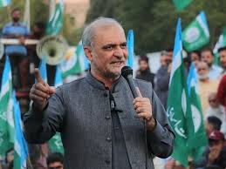



WAJAHAT ALI’s GROUP
BANO QABIL
MID TERM PROJECT
MOB: 0343-3380069
CHALAN: 260753

Slide 2
MID TERM PROJECT
WAJAHAT ALI
DANIYAL YOUSUF
(LEADER)
(MEMBER)
BANO QABIL
MID TERM PROJECT
MOB: 0343-3380069
CHALAN: 260753
BANO QABIL
MID TERM PROJECT
MOB: 0344 2139 501
CHALAN: 260754

Slide 3
OUR PROJECT
AUTOMATIC BILL SORTER
INTRODUCTION
We have created a system in which we save the data of customers and when we writes their ID and gets billed and we use many of formulas which sir AMJAD has taught us.

Slide 4
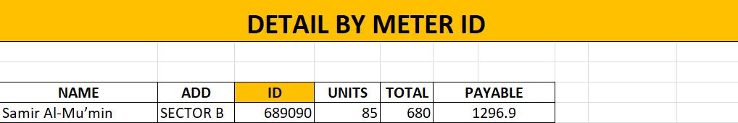
HOW IT WORKS
FIRST OF ALL
We will enter the ID in the space below. As shown in below. From which we will get the complete information of customer. Then press Ctrl + P bill will show on your screen.
There we will fill ID

Slide 5

FINAL RESULT
HERE IS FINAL LOOK
If you change ID, Customer name and data will automatically change.
And bill will also automatically fill.

Slide 6
WE HOPE
YOU WILL LIKE OUR PRESENTATION

Slide 7
THANK YOU

